Slide 1
What a Load of Barnacles! A Spatial Population Genomic Simulation of the Pacific Acorn Barnacle in Coos Bay
Alex Bangs, Angel Rivera-Colon, Jiseon Min, Peter Ralph
Kern Ralph Co-lab
SPUR Symposium
August 22, 2024

Slide 2
What a Load of Barnacles! A Spatial Population Genomic Simulation of the Pacific Acorn Barnacle in Coos Bay
Simulating a group of organisms and the interactions between them
Using computers to various ecological scenarios
Seeing how the population and their genome varies across a landscape
Observing and analyzing changes in the genome of the population
The Pacific Acorn Barnacle (Balanus glandula) is the organism we’re studying
The Coos Estuary is the landscape we’re studying B. glandula in

Slide 3
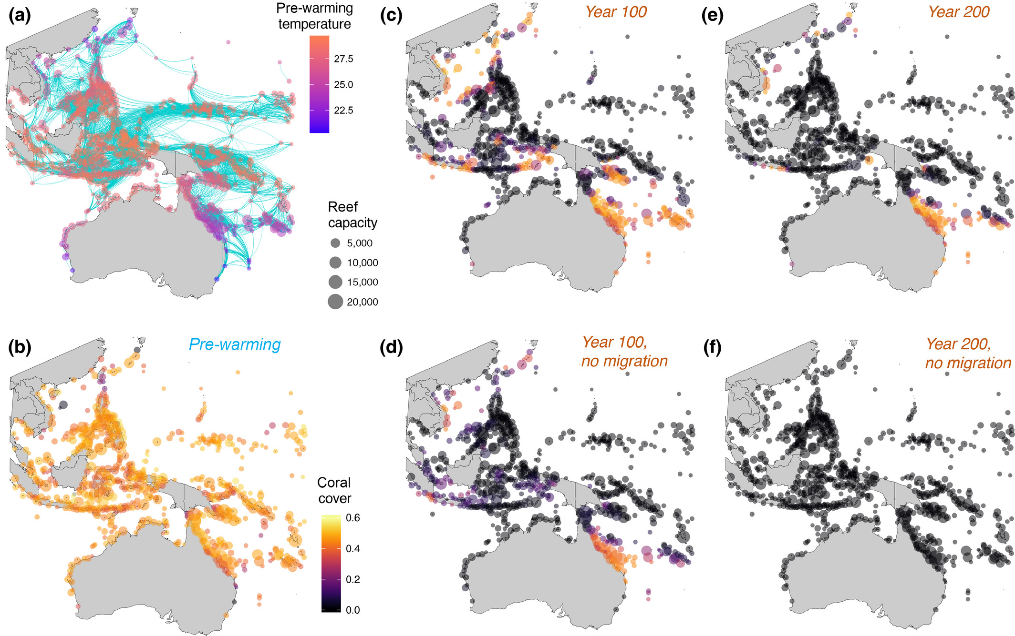
Why Do We Care About Simulations?
In general, they help us
Check our assumptions
Observe evolution at scale
Understand human impacts
Climate Change
Habitat loss (and gain)
Pollution and subsequent mitigation efforts
For the Pacific acorn barnacle specifically, we can
Strengthen our understanding
Study adaptation
Understand human estuary use
Notes:
Less much less text here
Lean more into modeling barnacles as a tool for understanding ecosystem health with Climate Change
In general, they help us
Check our assumptions and beliefs about how ecology, evolution and genomics work
Observe evolution on much greater spatial and temporal scales than otherwise possible
Understand the impact humans have on ecosystems, such as
Climate Change
Habitat loss (and gain)
Pollution and subsequent mitigation efforts
For the Pacific acorn barnacle specifically, we can
Strengthen our understanding of how genomics works in organisms with large effective populations
Study adaptation to changing environments across large environmental gradients
Hypothesize how B. glandula fares under various levels of ocean warming and acidification
See how human use of estuaries and the ocean results in changes to habitat and the spreading of invasive species

Slide 4
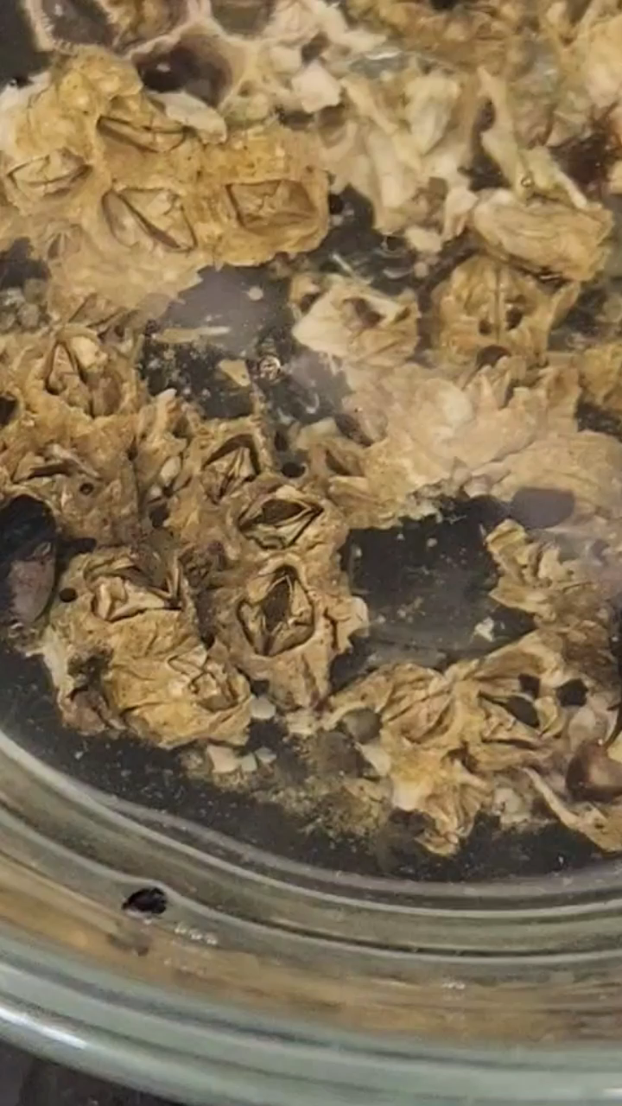
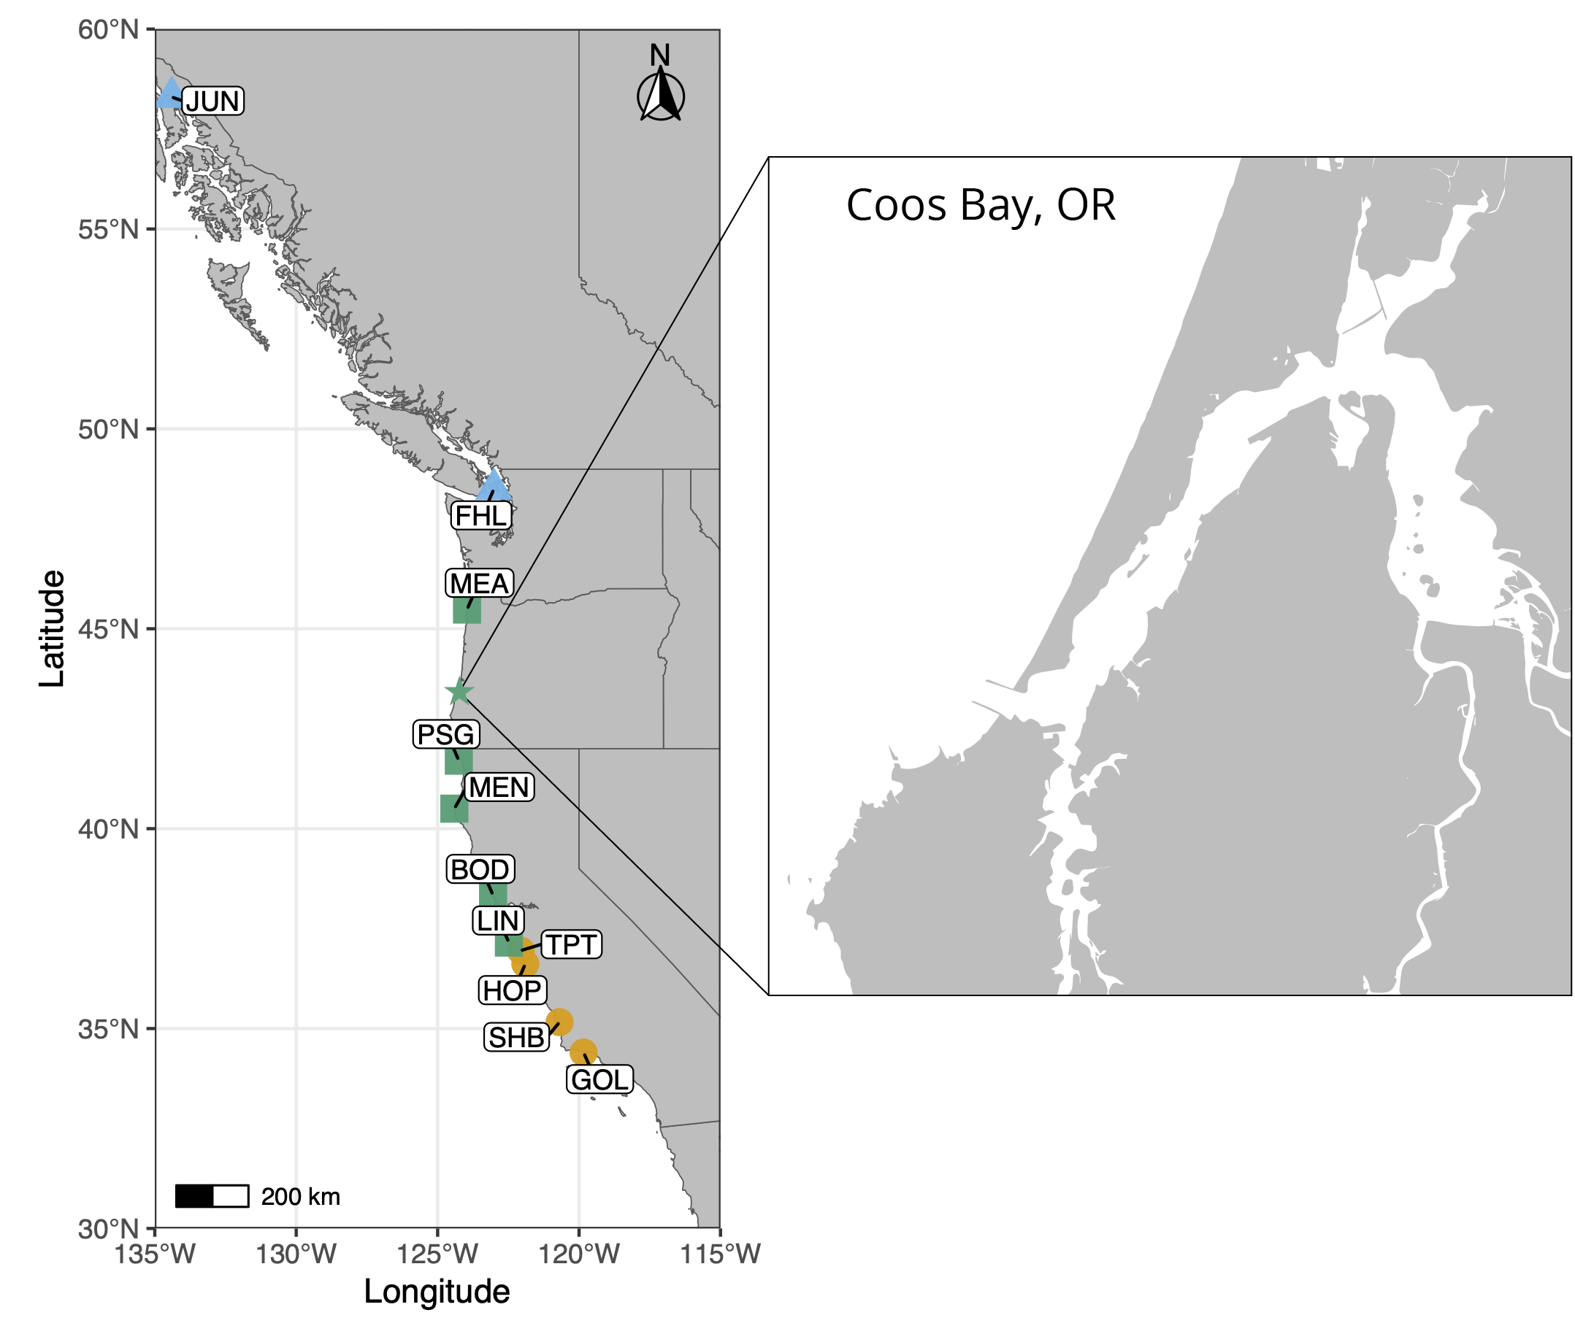
A Refresher
Credit to Erin Jezuit, 2024
Notes:
Good to include video of barnacles
Bryan also liked putting this in context with the picture of the west cost
Put timing for life stages

Slide 5
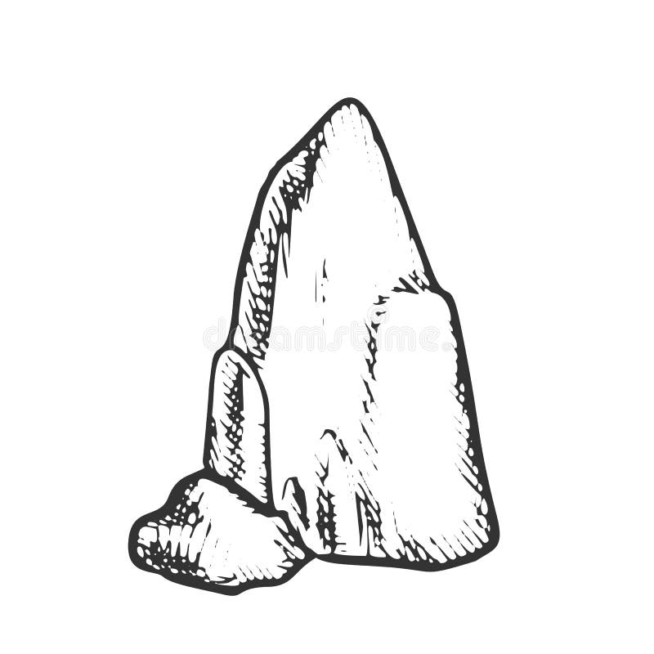
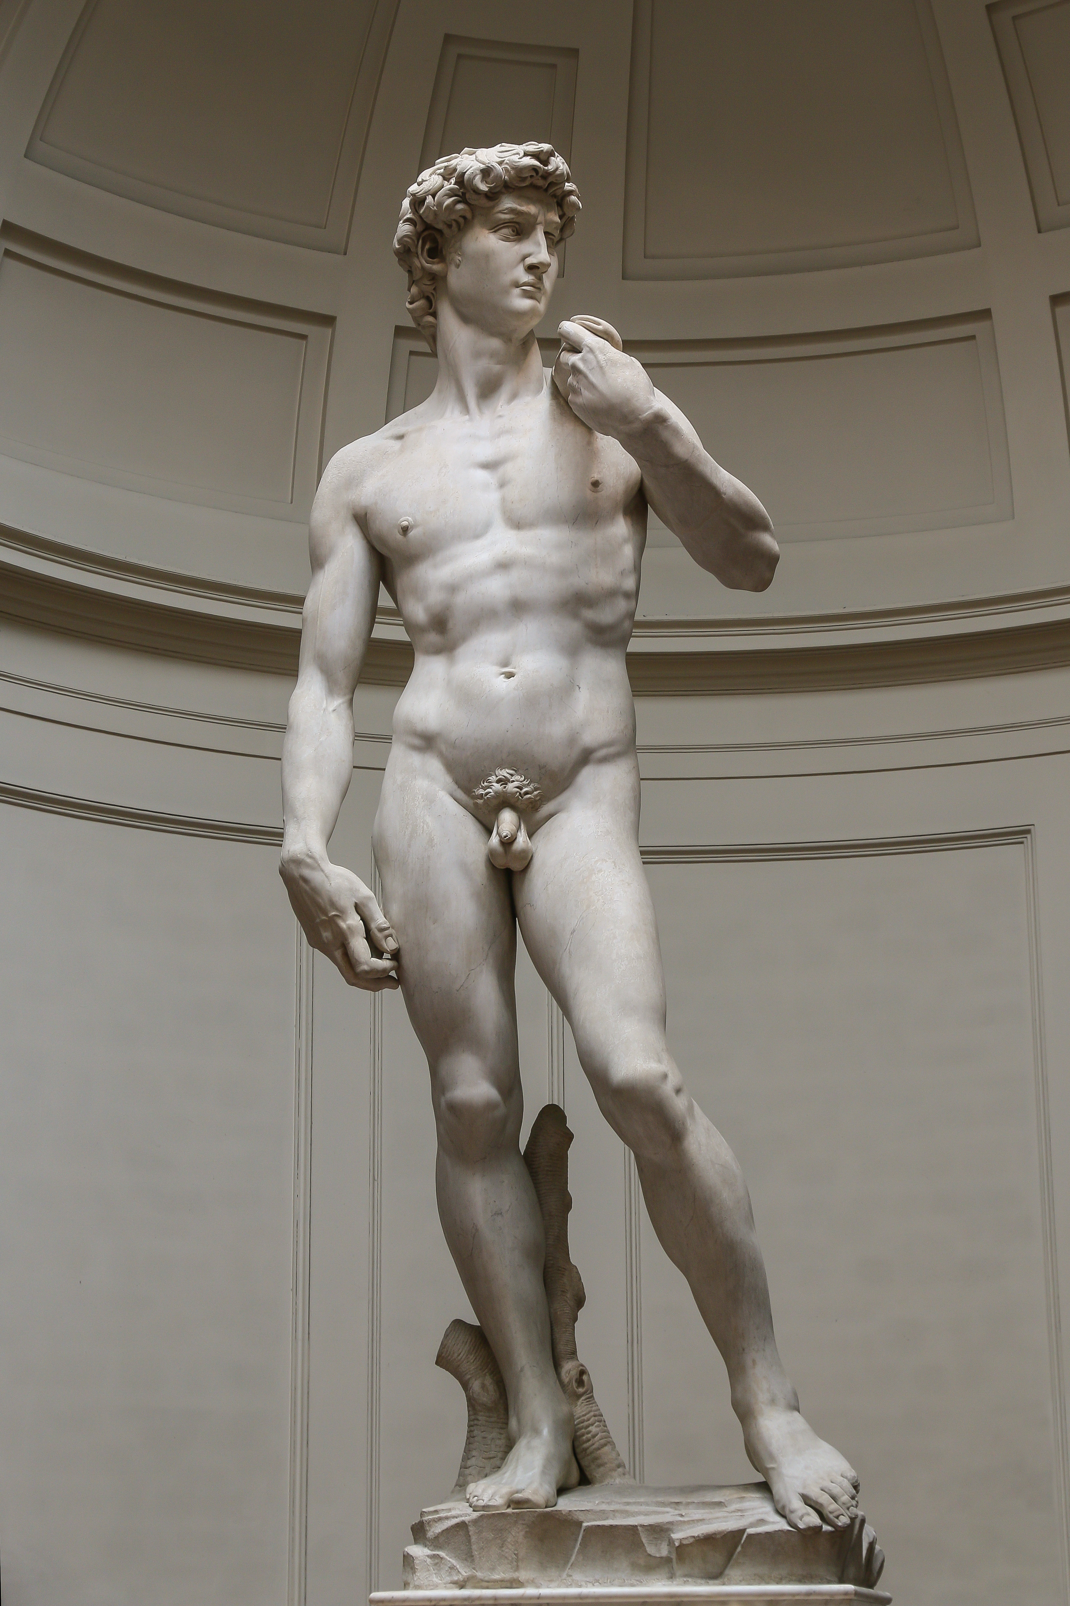
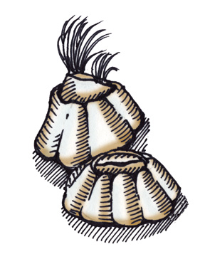

Is it even possible to model barnacles? Yes!
Notes:
Michelangelo’s David, Photo by Jörg Bittner Unna - Own work, CC BY 3.0, https://commons.wikimedia.org/w/index.php?curid=56633971

Slide 6
So, what do we have to account for?
Population size
Carrying Capacity
Life stages
Reproduction
Spatial mate choice
Dispersal
Settlement
Habitat availability
Spatial competition
Notes:
Hermaphroditic but self-fertilization is uncommon
Because adult barnacles are sessile (don’t move), they don’t have much ability to seek out a fit mate. Instead, they use an external appendage to reproduce with their neighbors
Unlike most sessile organisms, barnacles have internal fertilization. That means they keep their eggs inside of them instead of fertilizing them after they’ve been laid
They also have a reproductive window during which they produce multiple broods of offspring
Put more focus on the graph, the words should be verbal
List (very basic) what we add to make the organisms look like barnacles

Slide 7
Is it even possible to model barnacles? Yes!
Hermaphroditic (each barnacle produces both sperm and eggs)
Adults reproduce with close neighbors using an appendage
Internal fertilization with discharge of offspring
Produce multiple broods of offspring during reproductive season
Notes:
Hermaphroditic but self-fertilization is uncommon
Because adult barnacles are sessile (don’t move), they don’t have much ability to seek out a fit mate. Instead, they use an external appendage to reproduce with their neighbors
Unlike most sessile organisms, barnacles have internal fertilization. That means they keep their eggs inside of them instead of fertilizing them after they’ve been laid
They also have a reproductive window during which they produce multiple broods of offspring
Put more focus on the graph, the words should be verbal

Slide 8
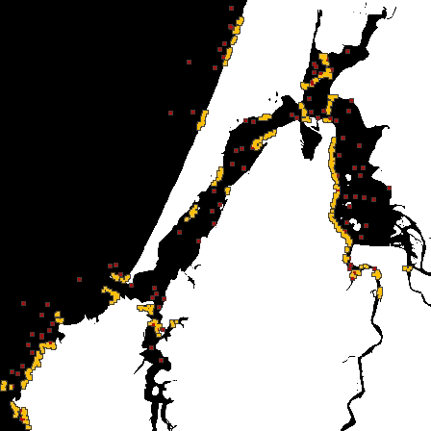
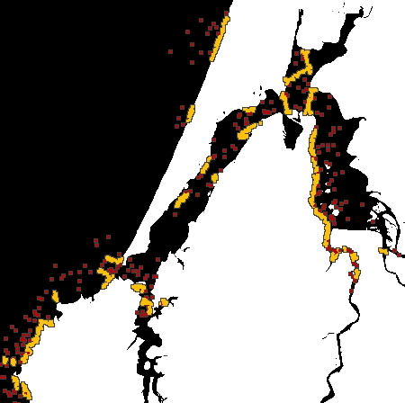
Creating a Stable Foundation
Continuous Reproduction
Seasonal Reproduction
Larvae
Juveniles
Adults
Notes:
Kay liked mentioning that the Continuous Reproduction initially peaked over carrying-capacity and then crashed

Slide 9
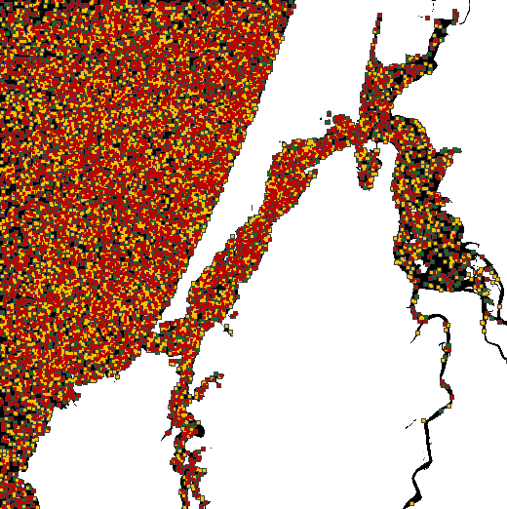
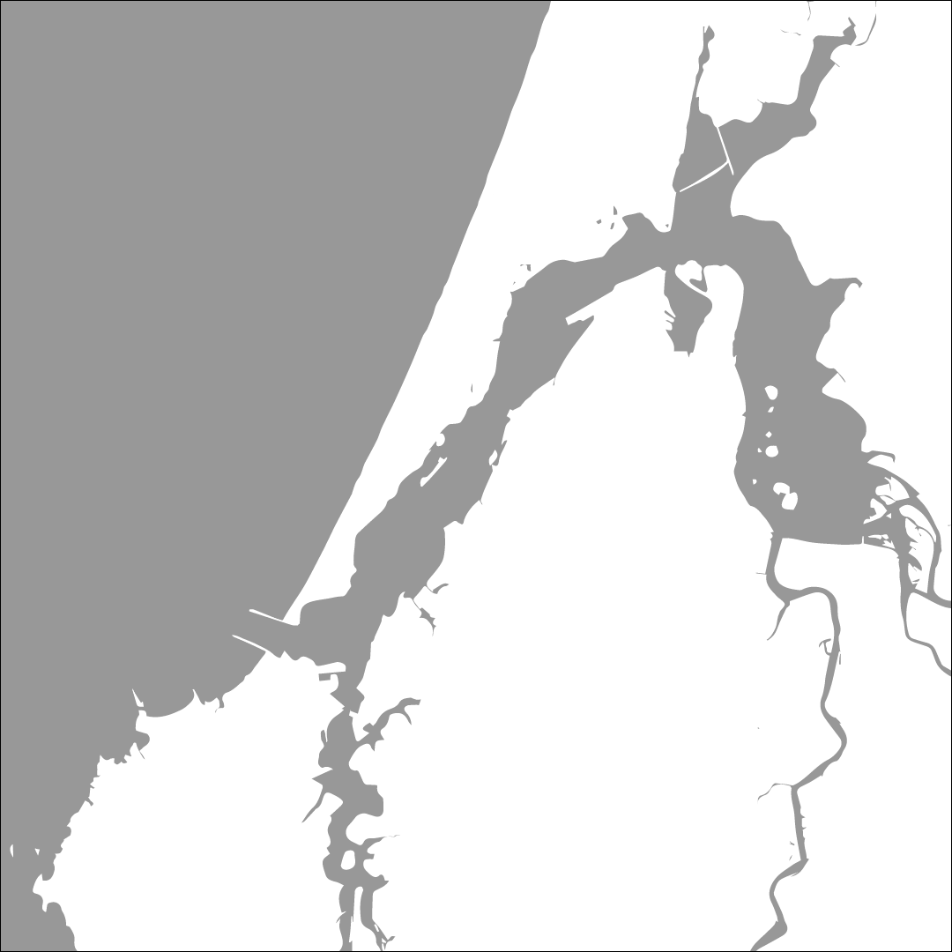
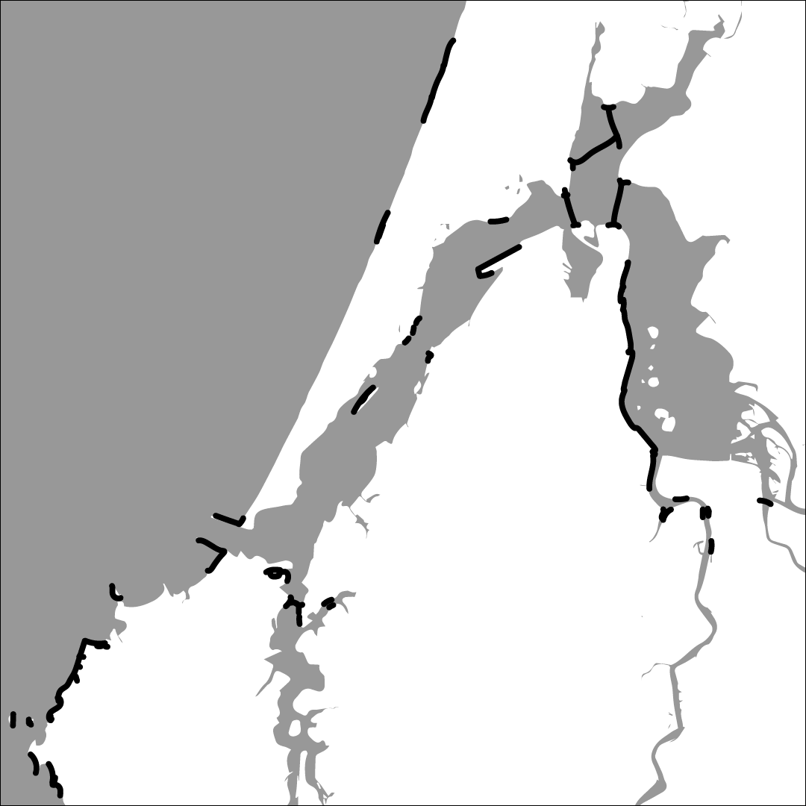
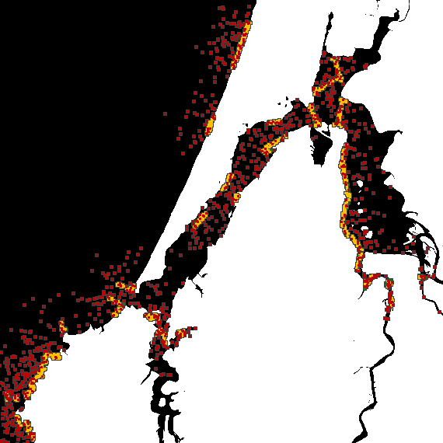
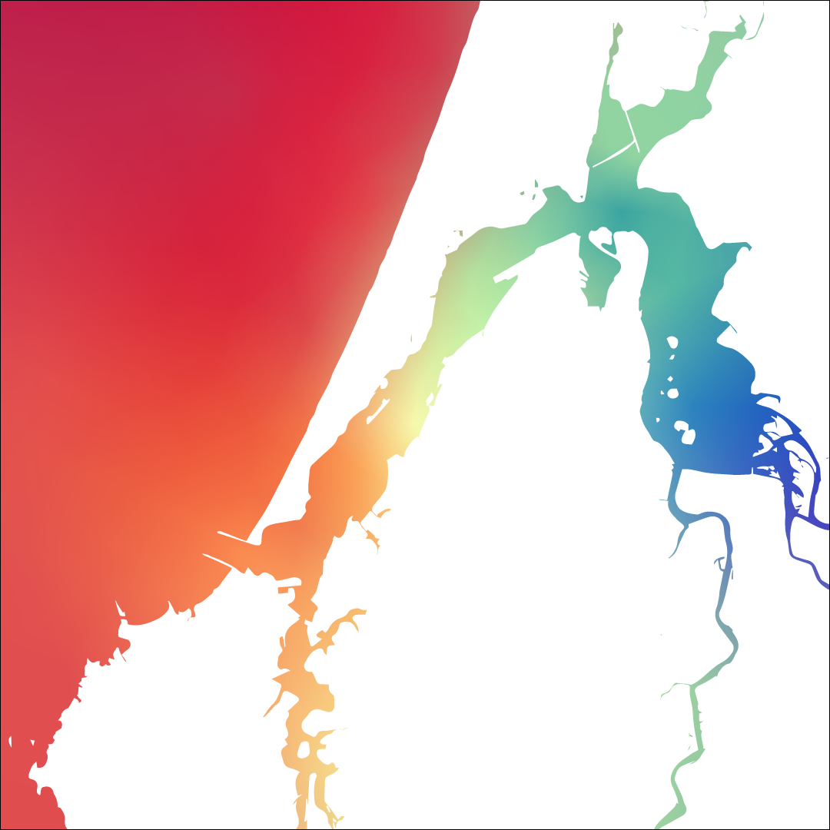
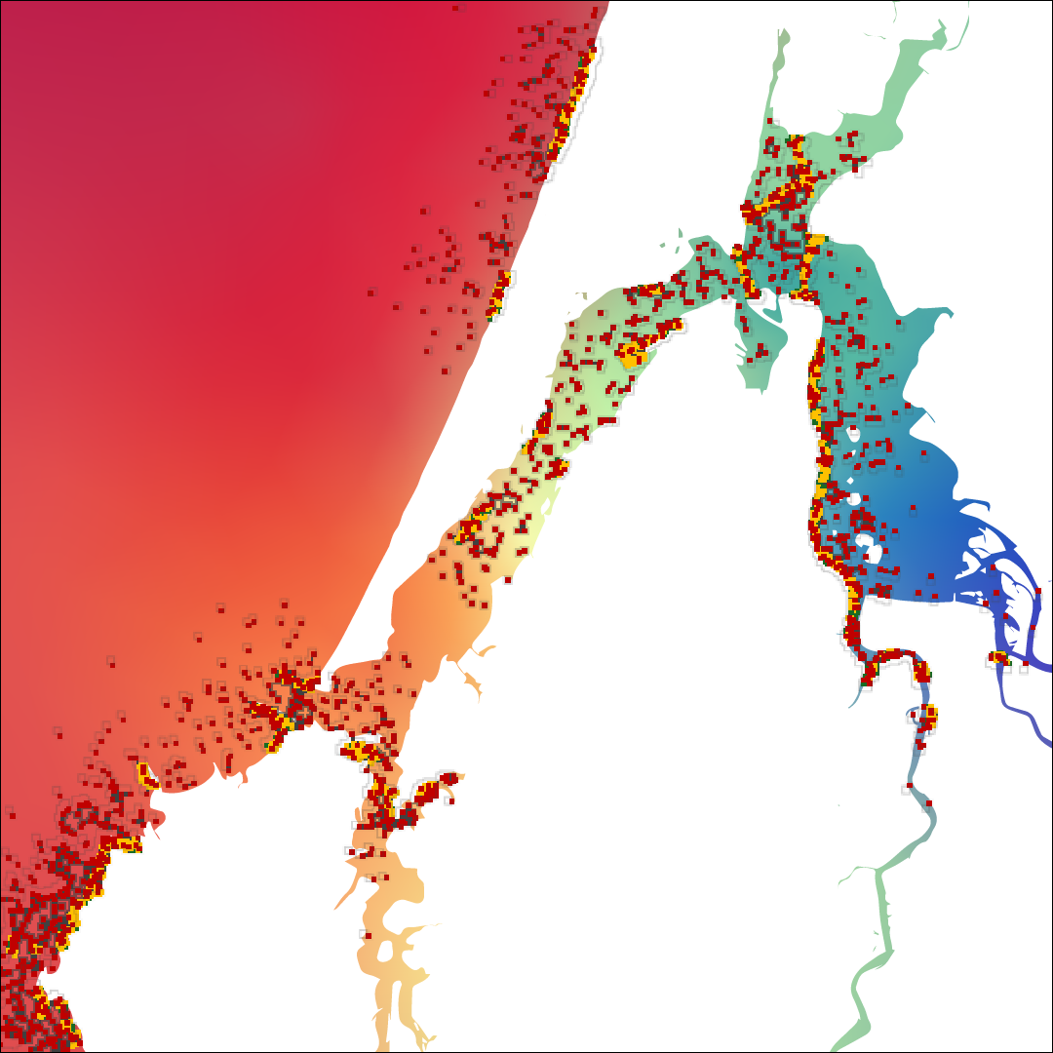
How do we then include environmental variables?
Coastline of Coos Bay, OR
+ Settlement Habitat
Salinity
Notes:
Kay liked mentioning that the Continuous Reproduction initially peaked over carrying-capacity and then crashed

Slide 10
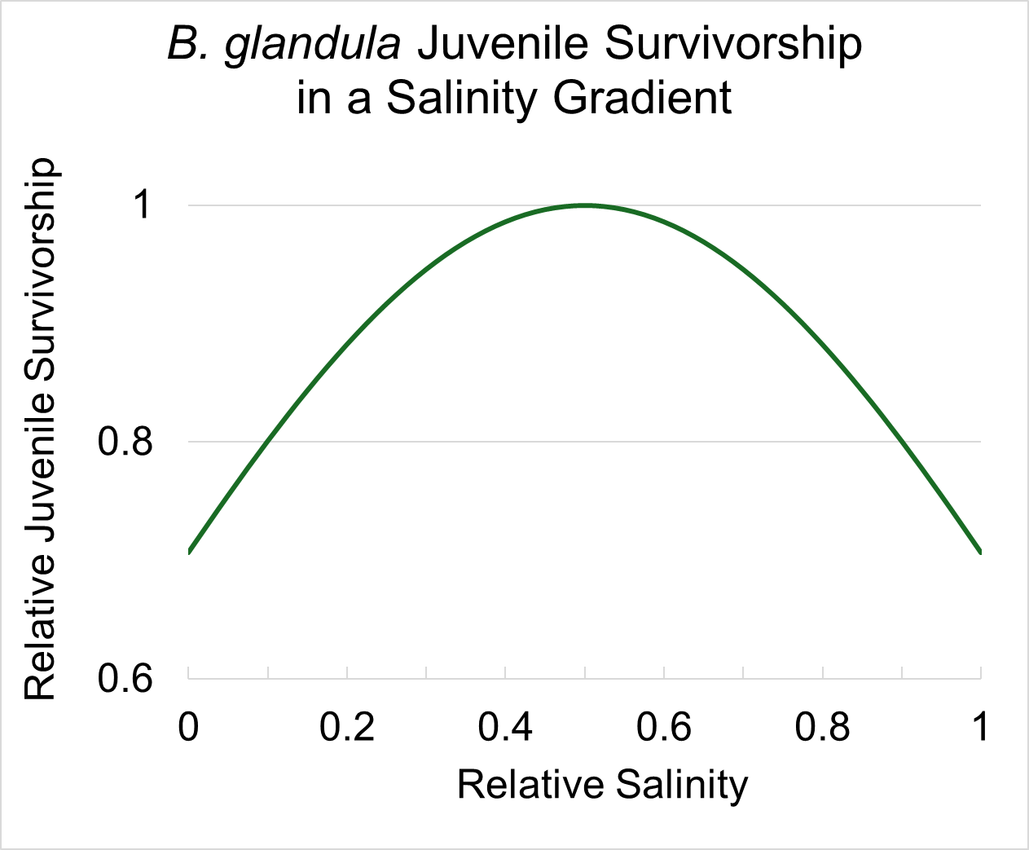
How are our barnacles affected by the environmental variables?
Notes:
Kay liked mentioning that the Continuous Reproduction initially peaked over carrying-capacity and then crashed

Slide 11
How can we simulate local adaptation under Climate Change?
Notes:
Kay liked mentioning that the Continuous Reproduction initially peaked over carrying-capacity and then crashed

Slide 12
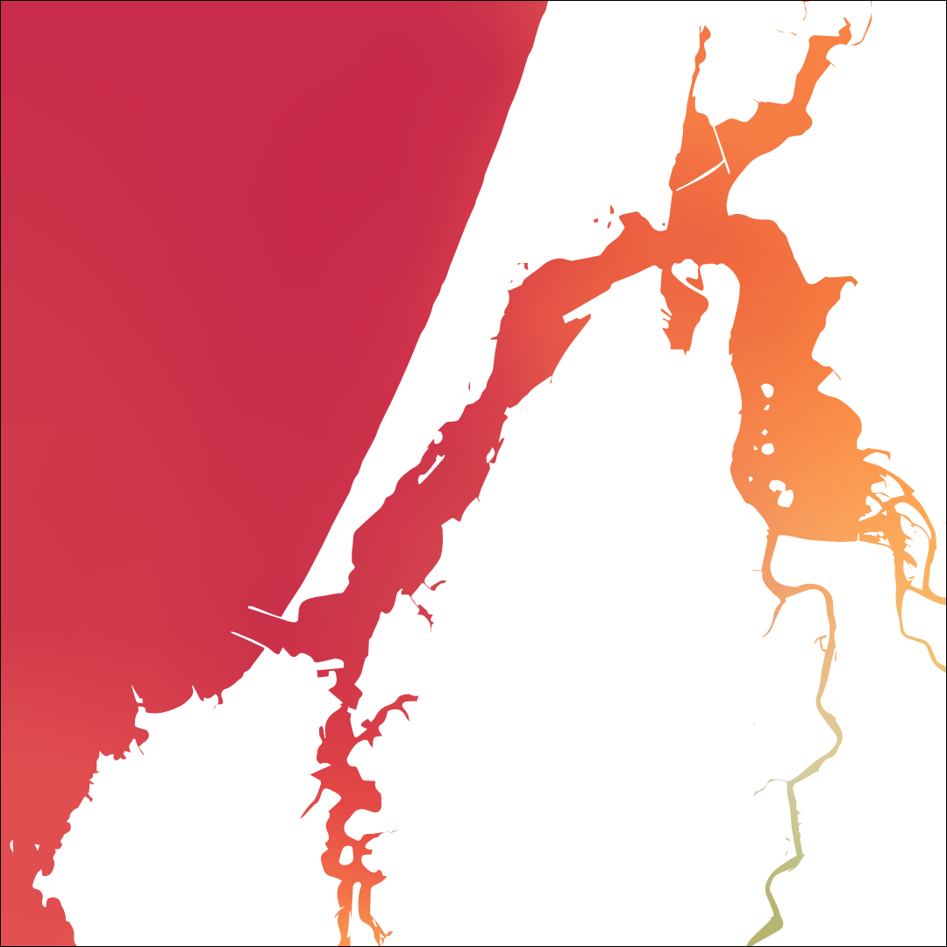
Why do we care about simulations? What comes next?
Notes:
Include cline from John’s Paper to connect back to larger project

Slide 13
Acknowledgements and References
Thank you to Erin Jesuit of the VonDassow Lab at OIMB for your help sampling and analyzing B. glandula samples. To the entirety of the Kern Ralph Co-Lab for being a wonderful group to collaborate and research with. To Ben Haller and Philipp Messer for the development of SLiM: An Evolutionary Simulation Framework. And to the University of Oregon Summer Program for Undergraduate Research and the Mary G. Alden Fellowship for the opportunity to pursue summer research.
Berger, M. S. (2009). Reproduction of the Intertidal Barnacle Balanus Glandula Along an Estuarine Gradient. Marine Ecology, 30(3), 346–353. https://doi.org/10.1111/j.1439-0485.2009.00280.x
Berger, M. S., Darrah, A. J., & Emlet, R. B. (2006). Spatial and temporal variability of early post-settlement survivorship and growth in the barnacle Balanus glandula along an estuarine gradient—ScienceDirect. Journal of Experimental Marine Biology and Ecology, 336(1), 74–87.
Conroy, T., Sutherland, D. A., & Ralston, D. K. (2020). Estuarine Exchange Flow Variability in a Seasonal, Segmented Estuary. Journal of Physical Oceanography, 50(3), 595-613, 50(3), 595–613.
Haller, B. C., & Messer, P. W. (2023). SLiM 4: Multispecies Eco-Evolutionary Modeling. The American Naturalist, 201(5), E127–E139. https://doi.org/10.1086/723601
Hiebert, T. C., & Jarvis, M. (2015). Balanus glandula. In Oregon Estuarine Invertebrates: Rudys’ Guide to Common Species (3rd ed., pp. 574–580). University of Oregon Libraries and Oregon Institute of Marine Biology.
Marin Jarrin, M. J., & Sutherland, D. A. (2022). Wind Effects on the Circulation of a Geometrically-Complex Small Estuary. Estuarine, Coastal and Shelf Science, 278, 108092. https://doi.org/10.1016/j.ecss.2022.108092
Notes:
Presentation was 20 minutes, need to cut that down significantly

